Slide 1
Graph Explanation

Slide 2
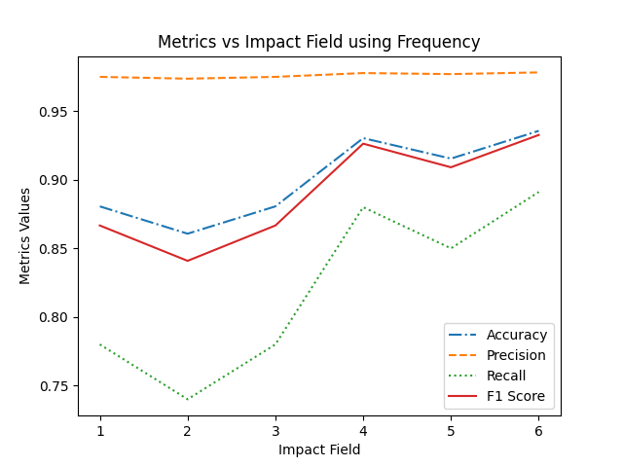
Frequency
Variable Parameter: In this graph, we varied number of impacted field because of the attack. Number of system calls were kept fixed. We used only those system calls who showed significant change during the attack.
Observations: The more severe the attack, the easier it is for us to detect using frequency of system call. But as we can see the curve is not regular. The reason behind it is:
We have taken 100 samples of attack and benign behaviour(Total 200). As a result, little irregularity(5/10 samples) of some system calls could have caused the curve to show some irregularity.

Slide 3
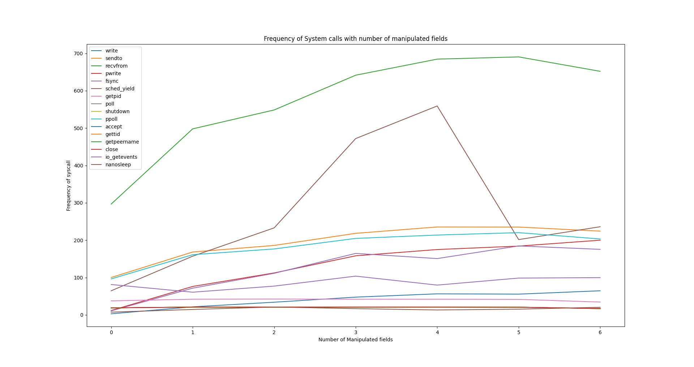
Frequency
Variable Parameters: Here we varied the number of manipulated fields again.
Observations: The main purpose of this graph is to identify the system calls that showed irregular behaviour. These system calls are the main reason of the irregularity of the previous graph. Generally, the frequency of each system call increase as the number of affected field increases.
Reason for Irregularity: For number of edited field= 3 and 4 sched_yield shows irregularity in only 4 samples but in great amount. We think this system call is automatically triggered with a certain frequency.

Slide 4
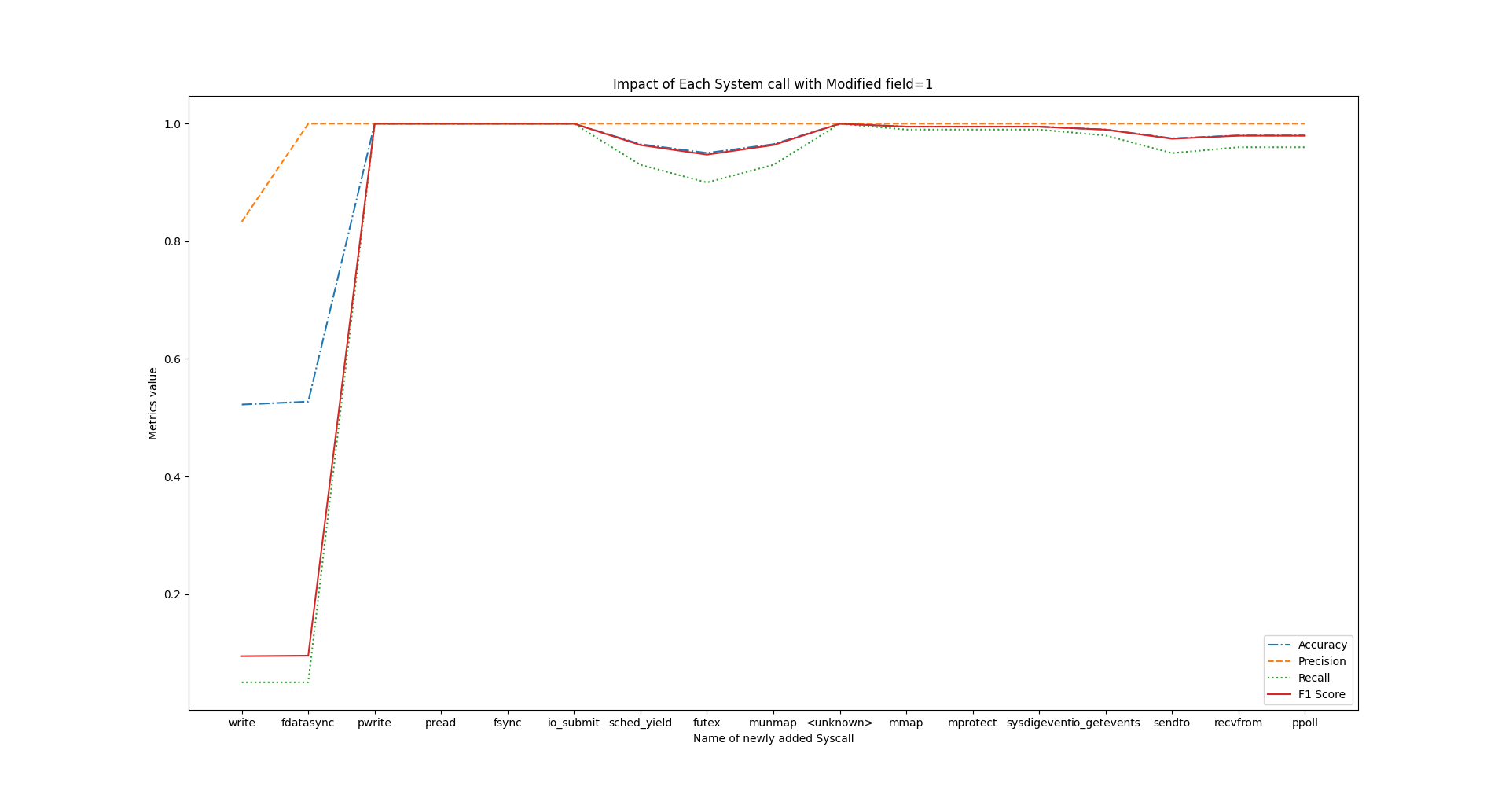
Frequency
Variable Parameters: In this graph, we manipulated only one field and calculated accuracy, precision, etc. Along the X-axis, each time we add a new system call to the previous calls.
Observations: From the graph, we can see that write, fdatasync, pwrite, pread, fsync, io_submit - if we use the frequency of these system calls, then the performance metrics show great improvement. But system calls like futex, shed_yield, munmap decrease the performance of our intrusion detection mechanism. And lastly, at the end of the graph, when lots of system calls comes into play, the performance metrics drops a little.

Slide 5
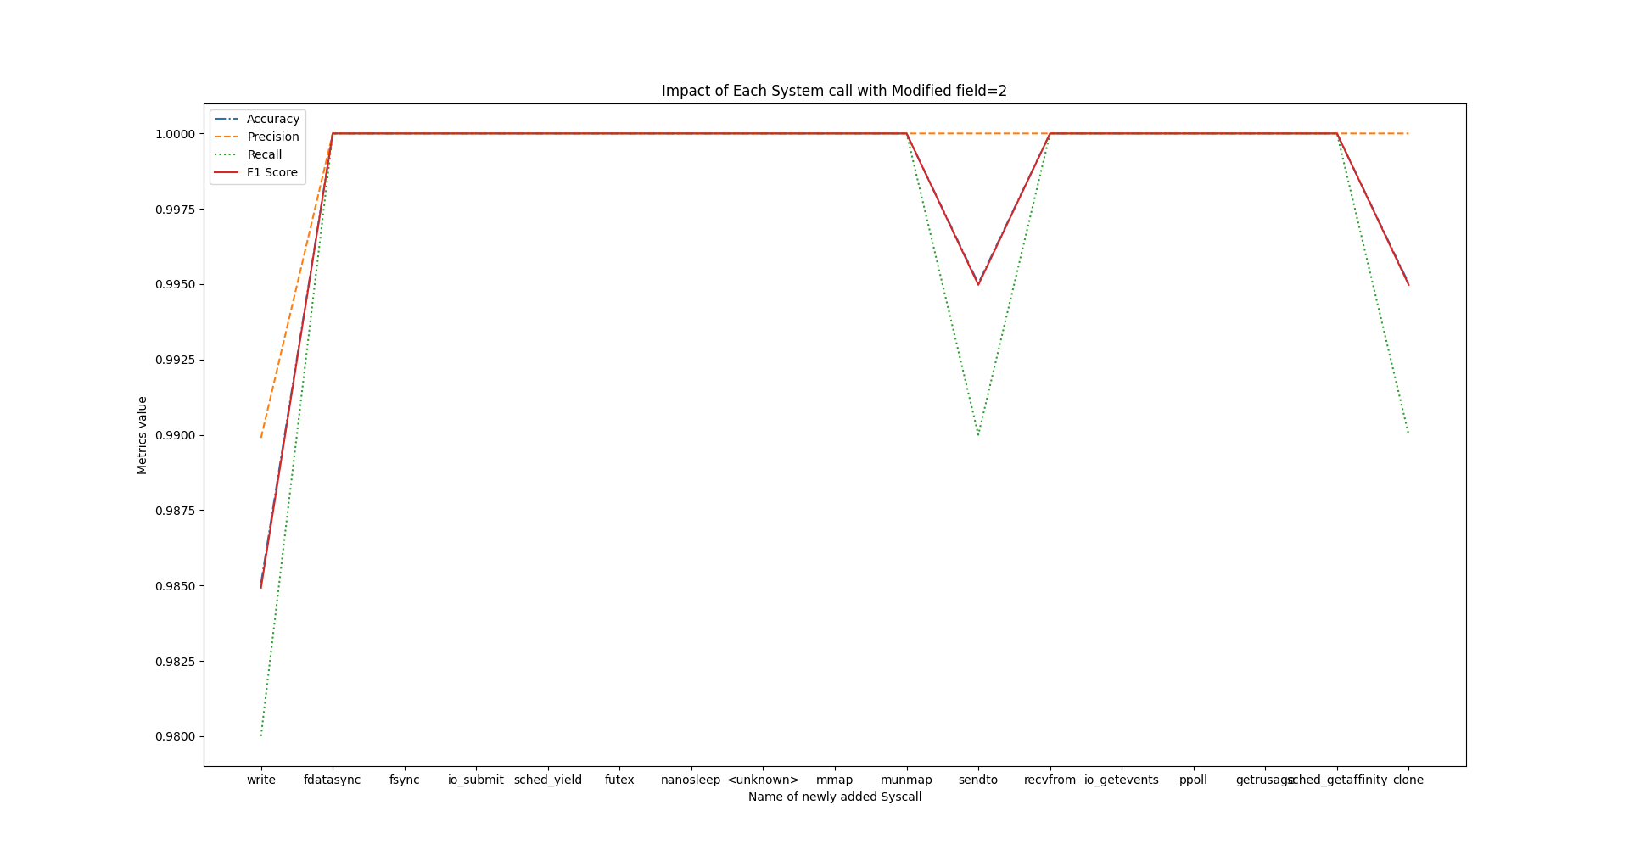
Frequency
Here we increased the number of manipulated field by 1 and we get the same observations as before. In the next 4 graphs we have just increased the number of manipulated fields and all graphs acts almost in the same manner.

Slide 6
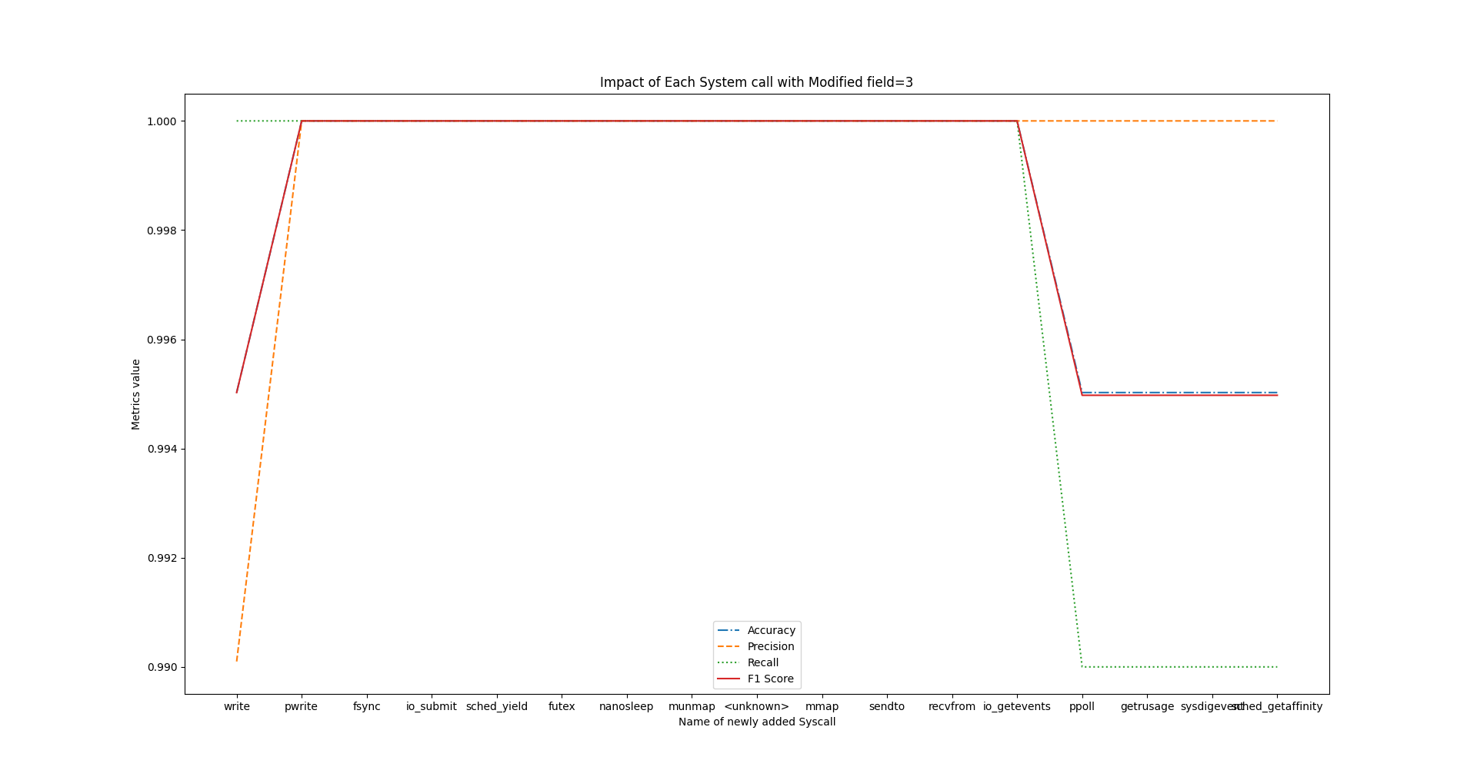
Frequency

Slide 7
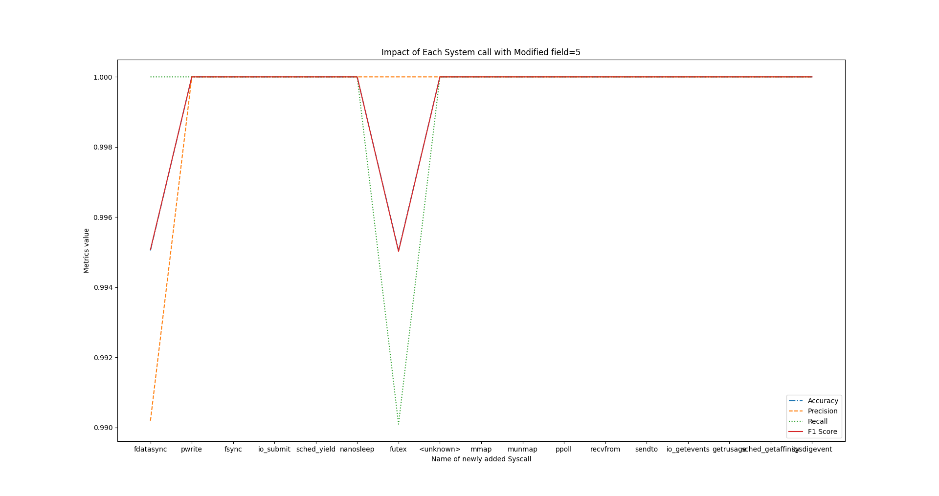
Frequency

Slide 8
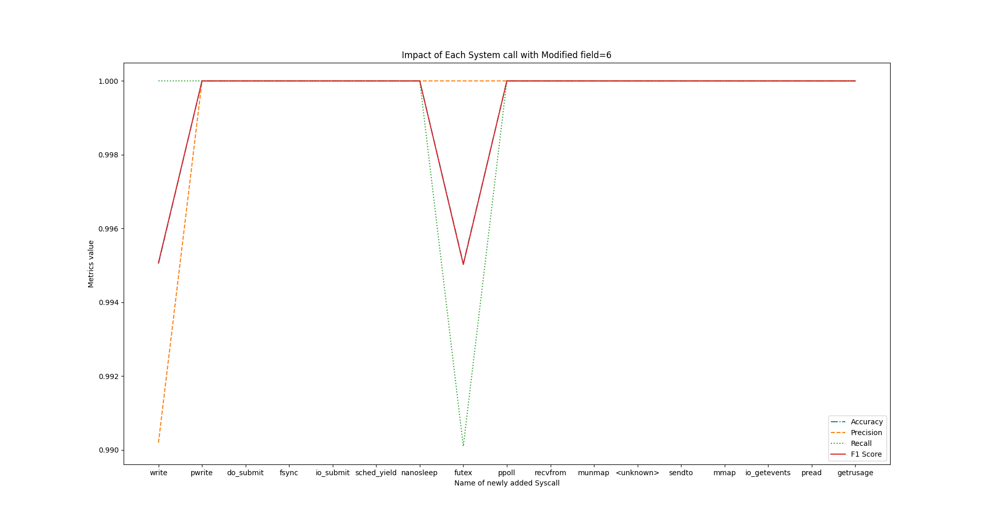
Frequency

Slide 9
Frequency

Slide 10
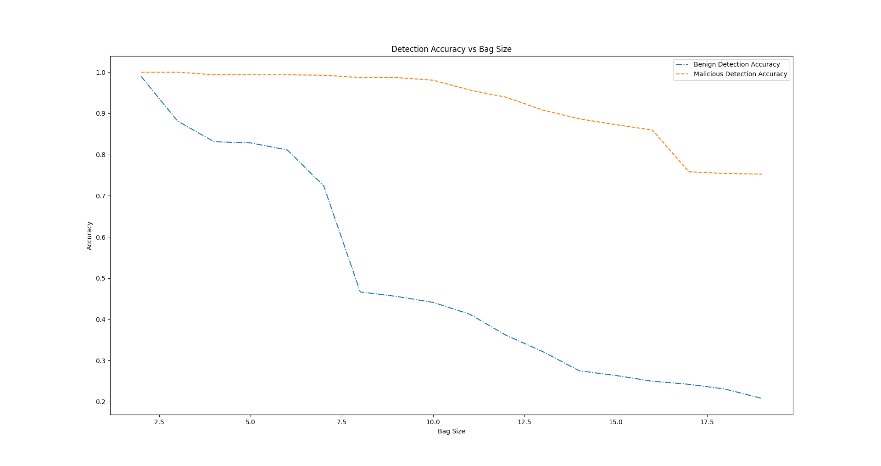
Sequence
Variable Parameters: To detect intrusion using sequence of system calls, we used BoSC(Bag of System Call) technique. In this graph, we varied the size of bag and calculated how accurately our system can identify benign and malicious sequence.
Observations: As we can see, accuracy drops drastically as we increase the bag size. For bag size ranging from 3 to 6, our system gives satisfactory accuracy.
Now as we increase the bag size, the sequence to match becomes longer and lots of new sequences come into play. We set a threshold to the number of mismatch we will tolerate in a small sequence. But as the size of the bag increases, it becomes very hard to match a sequence that big even with that tolerance.

Slide 11
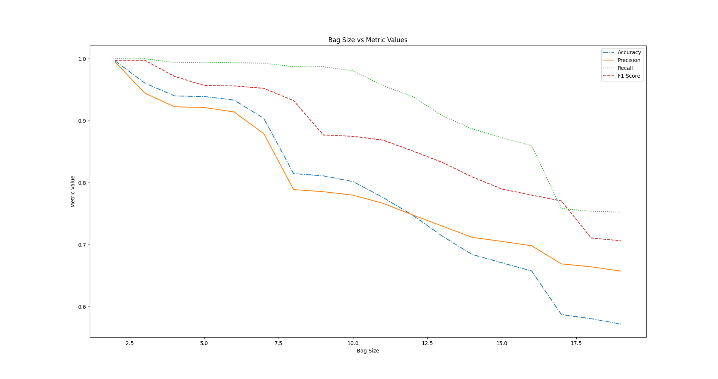
Sequence
Variable Parameter: We varied the bag size in this graph to calculate the performance metrics. To generate this graph, total of 10000 instances of malicious and benign were simulated.
Observations: Performance tends to drop if we increase the number of bag size. This was anticipated because of the high probability of mismatch if we increase the length of sequence.

Slide 12
Thank You

